Slide 1
Byers-Quaranta Collaboration
Sarah Groves
October 25, 2023

Slide 2
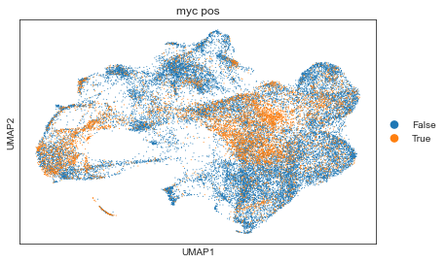
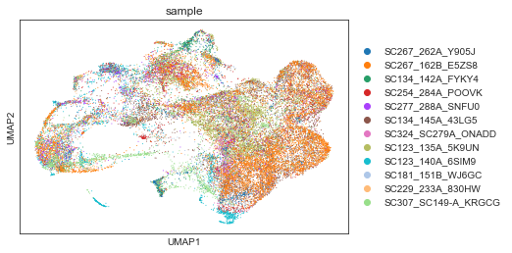
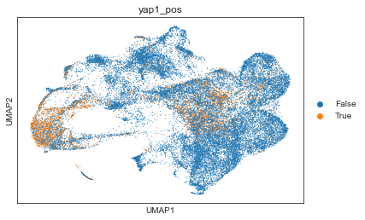
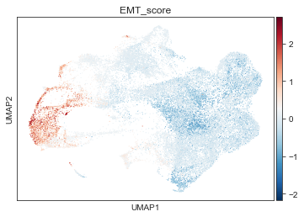

Slide 3
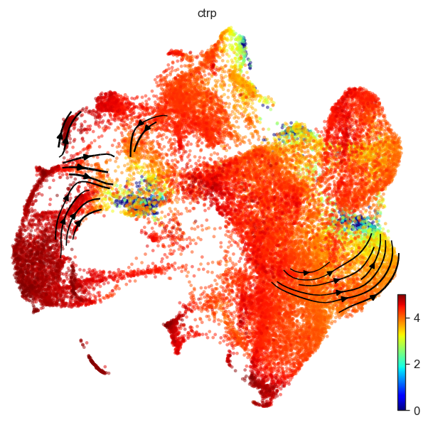
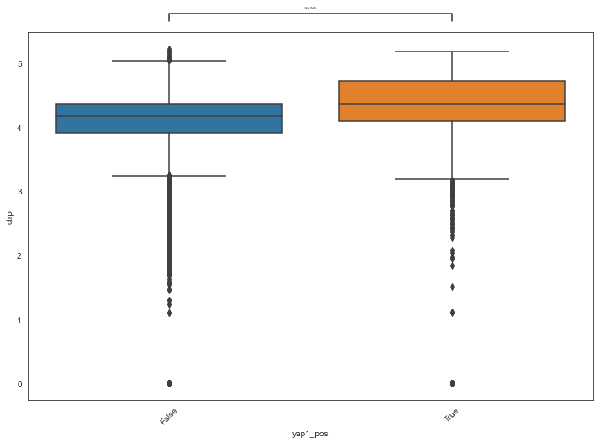
Cell Transport Potential
There are a few regions of low plasticity, but most cells are relatively high
EMT high cells and Yap1+ cells have highest plasticity
Yap1-
Yap1+

Slide 4
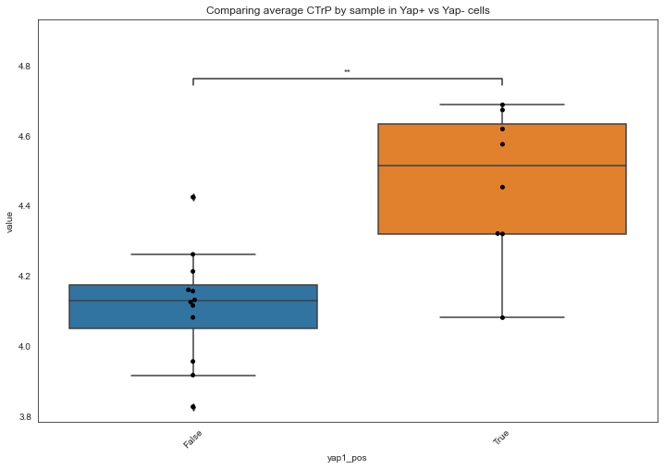
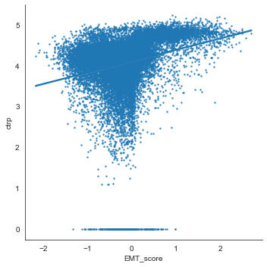
EMT high cells and Yap1+ cells have highest plasticity
EMT score is correlated with CTrP
When grouped by sample, there is a significant difference in CTrP for Yap1+ and Yap1- cells

Slide 5
Outline of analysis
Use velocyto package to get spliced and unspliced counts
Filter data to same genes and cells
Use scvelo package to calculate velocity (using dynamical model for each sample)
Evaluate fit likelihood for individual genes (top fit = “drivers” of velocity)
Use Cell Transport Potential to characterize high plasticity states and correlate with cell characteristics (Yap1+, Myc+, etc)

Slide 6
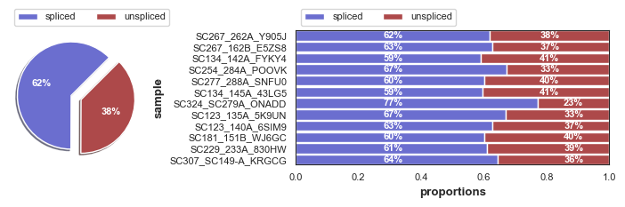
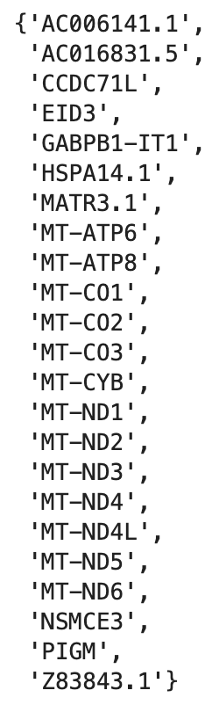
Data preprocessing
% spliced/unspliced consistent across samples
Filtered to 29841 cells x 7099 genes (compared to 7122 genes in your version)
Removed genes in fewer than 3 cells
With the caveats that 23 genes are missing and the data is normalized with Scanpy instead of Seurat, we can proceed.

Slide 7
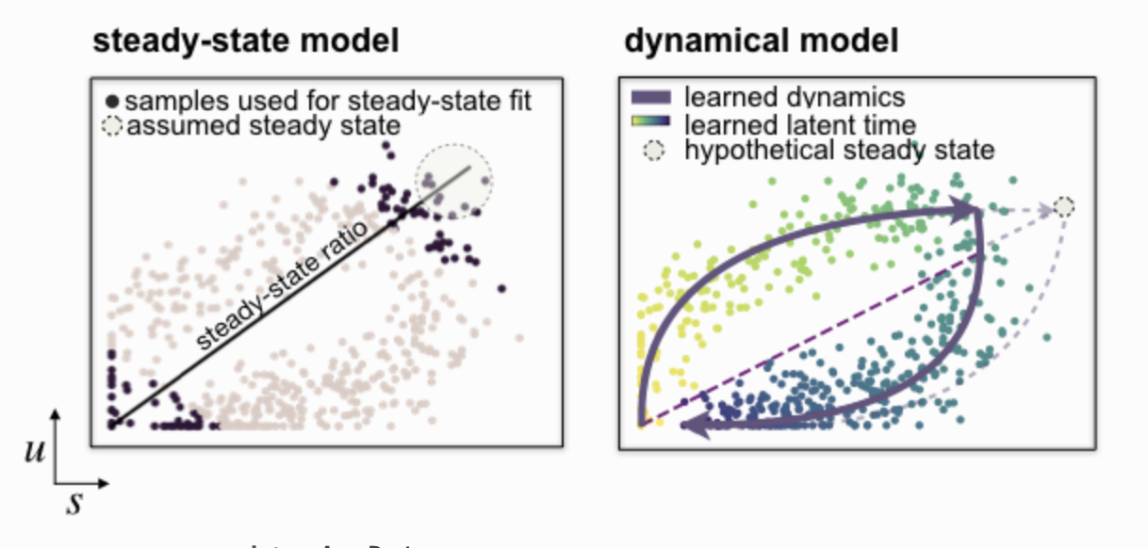
Calculating RNA velocity
Because each sample is independent, we want to calculate velocity independently
The most up-to-date version of scVelo is a ”dynamical” model, which solves the full transcriptional dynamics
Solved in a likelihood-based expectation-maximization framework by iteratively estimating reaction rates and cell-internal latent time to learn phase trajectory for each gene
Note: this does not fit every gene

Slide 8
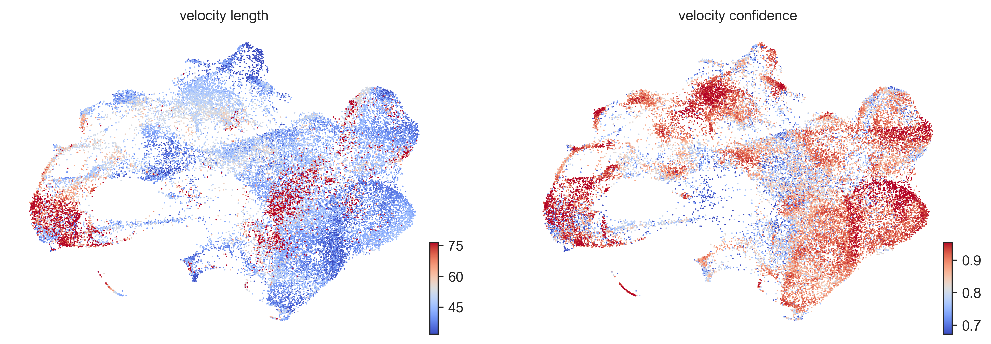
Velocity length and confidence
EMT+ cells have a higher velocity
These numbers can only give a general sense as to whether each cell is moving
Importantly, this is not a guarantee that the cells have significant RNA velocity

Slide 9
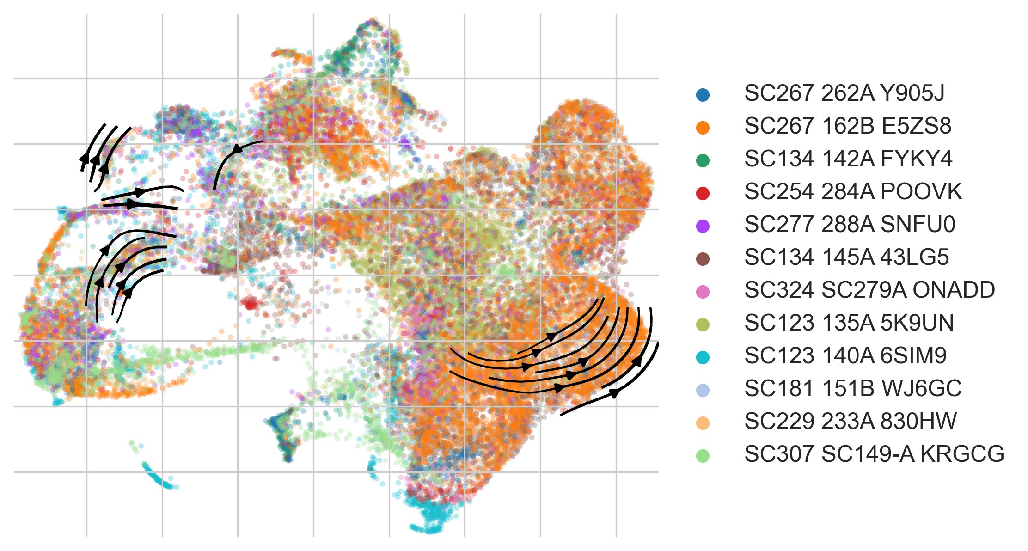
RNA velocity embedded in UMAP
I usually see more velocity streams than this, but in small regions of the UMAP there is relatively high velocity (threshold 4/5 on velocity ensures we are only seeing the most confident streams)

Slide 10
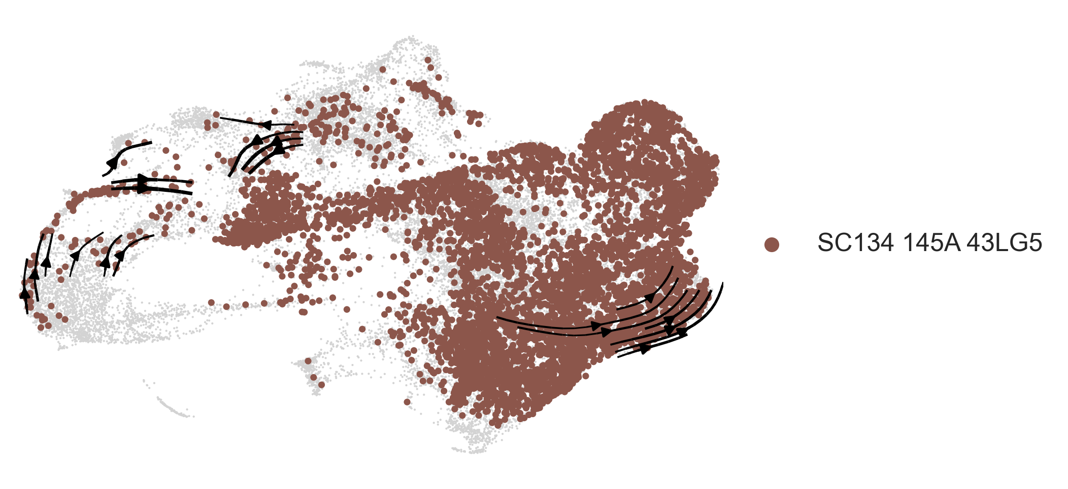
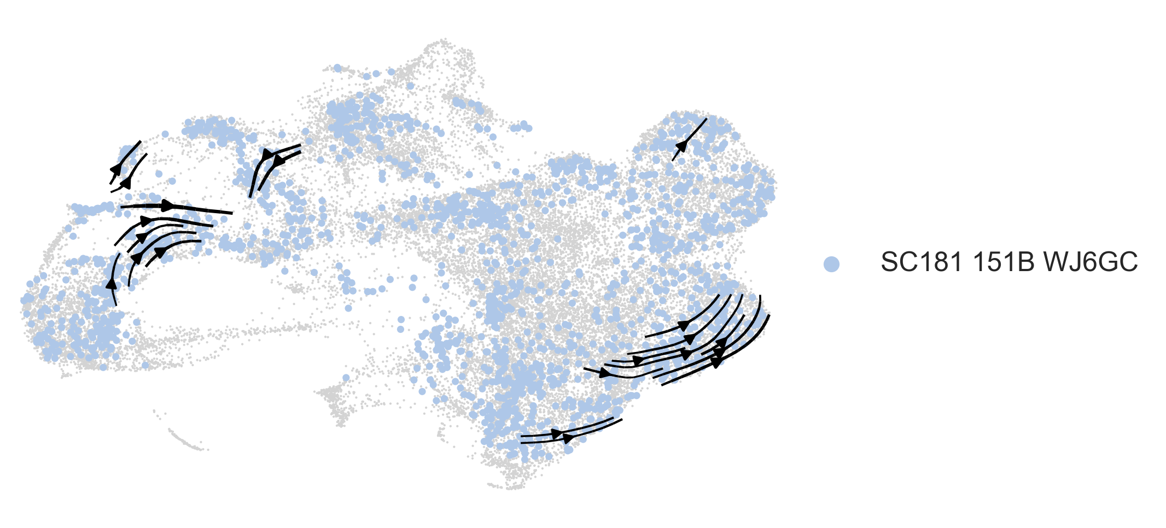
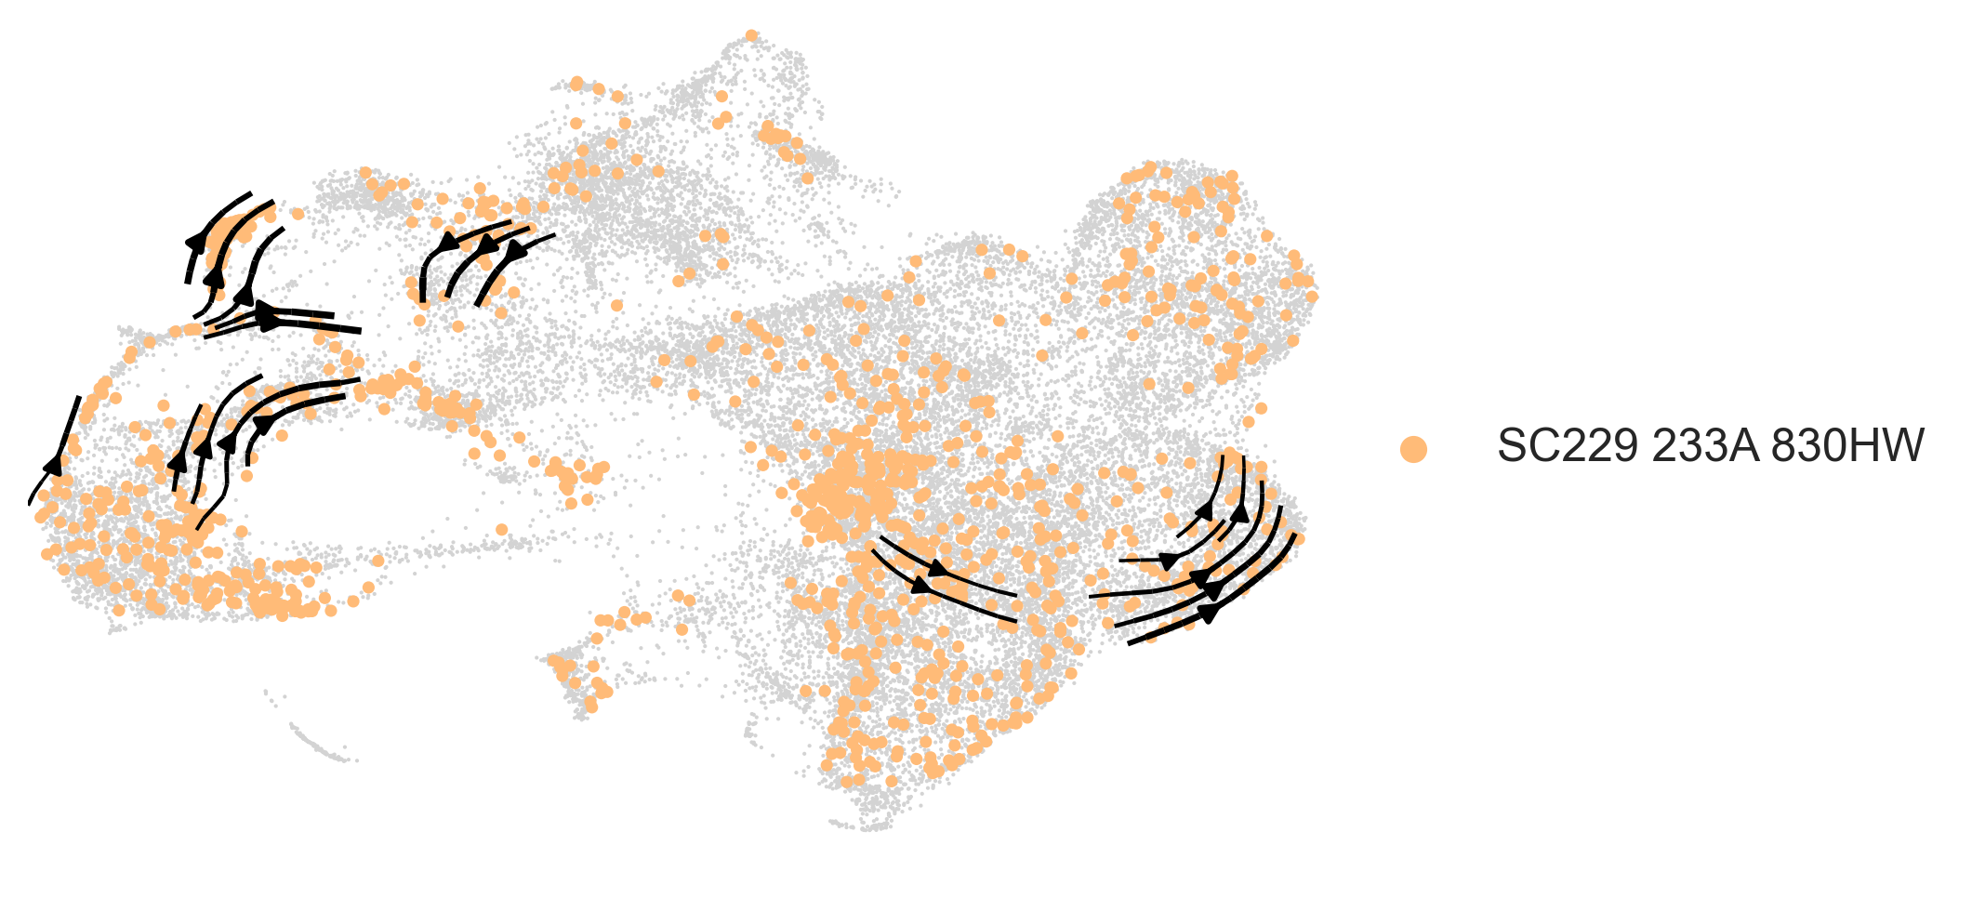
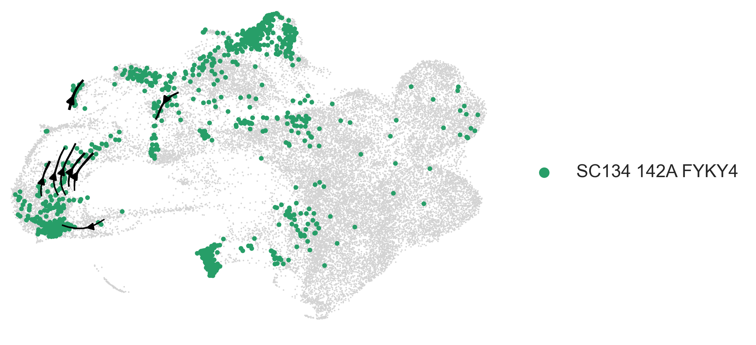
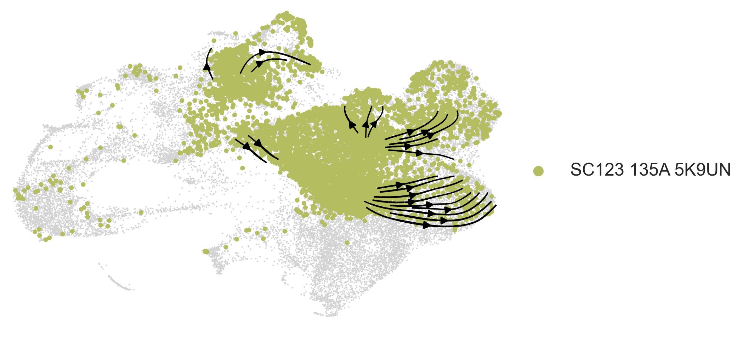
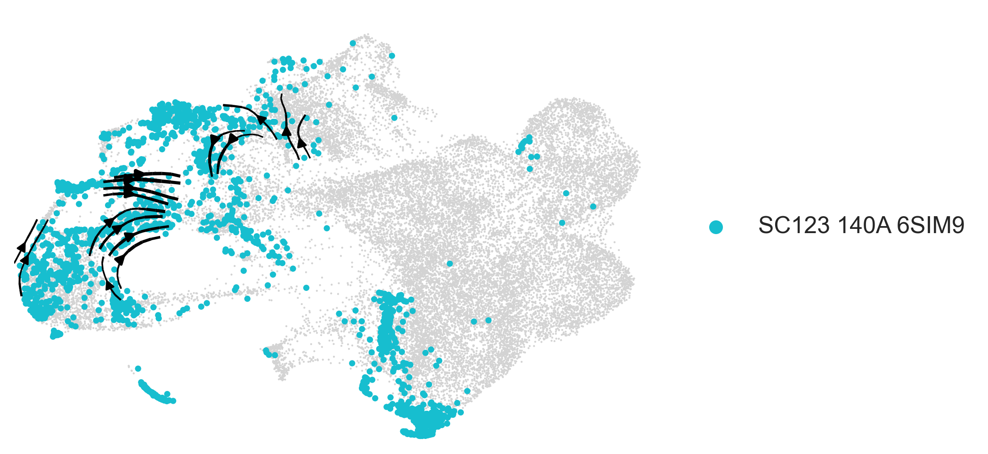
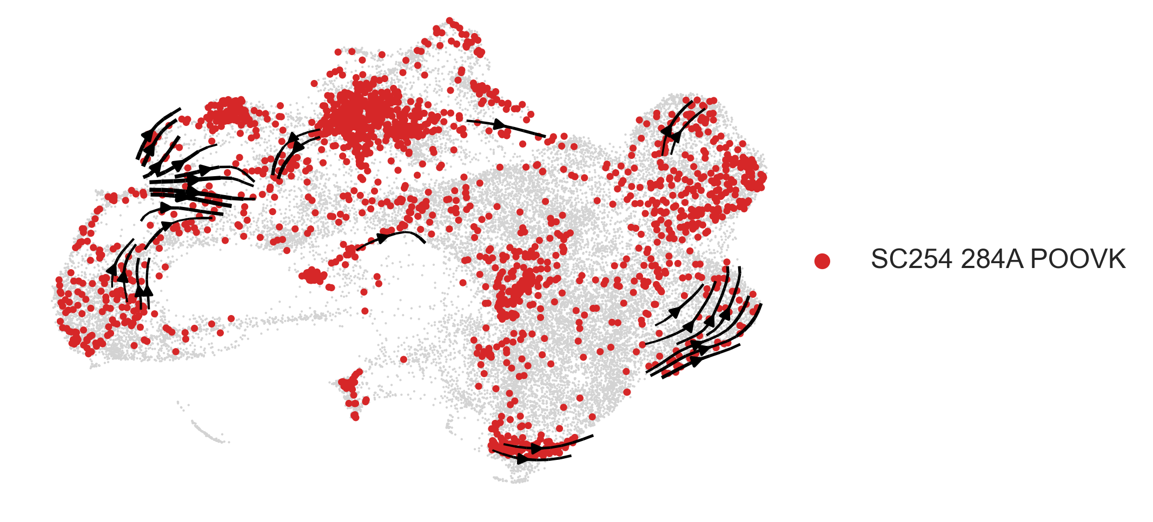
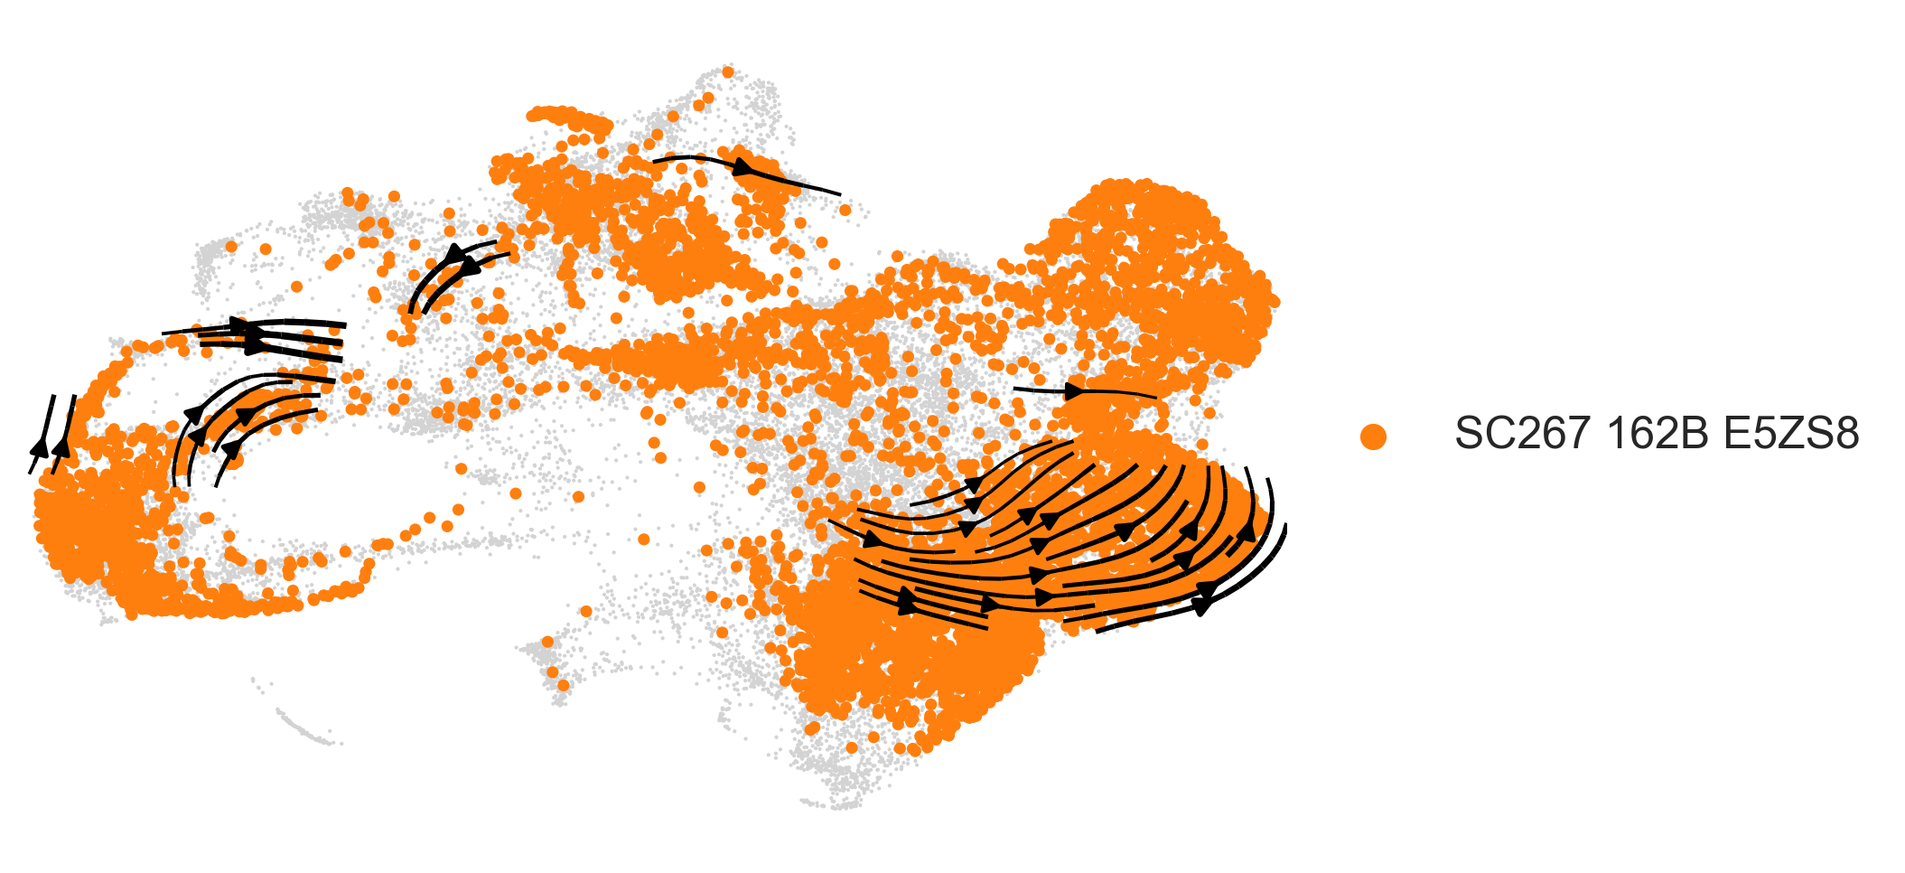
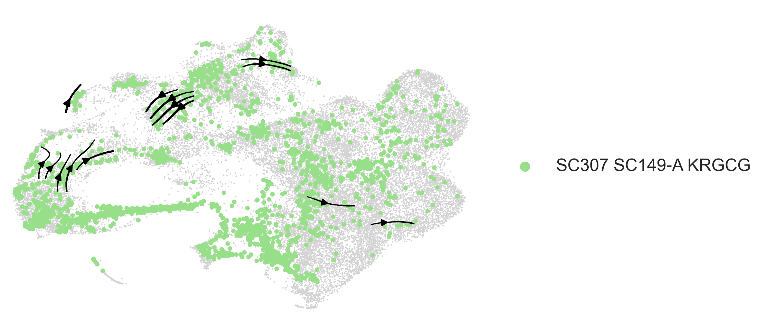
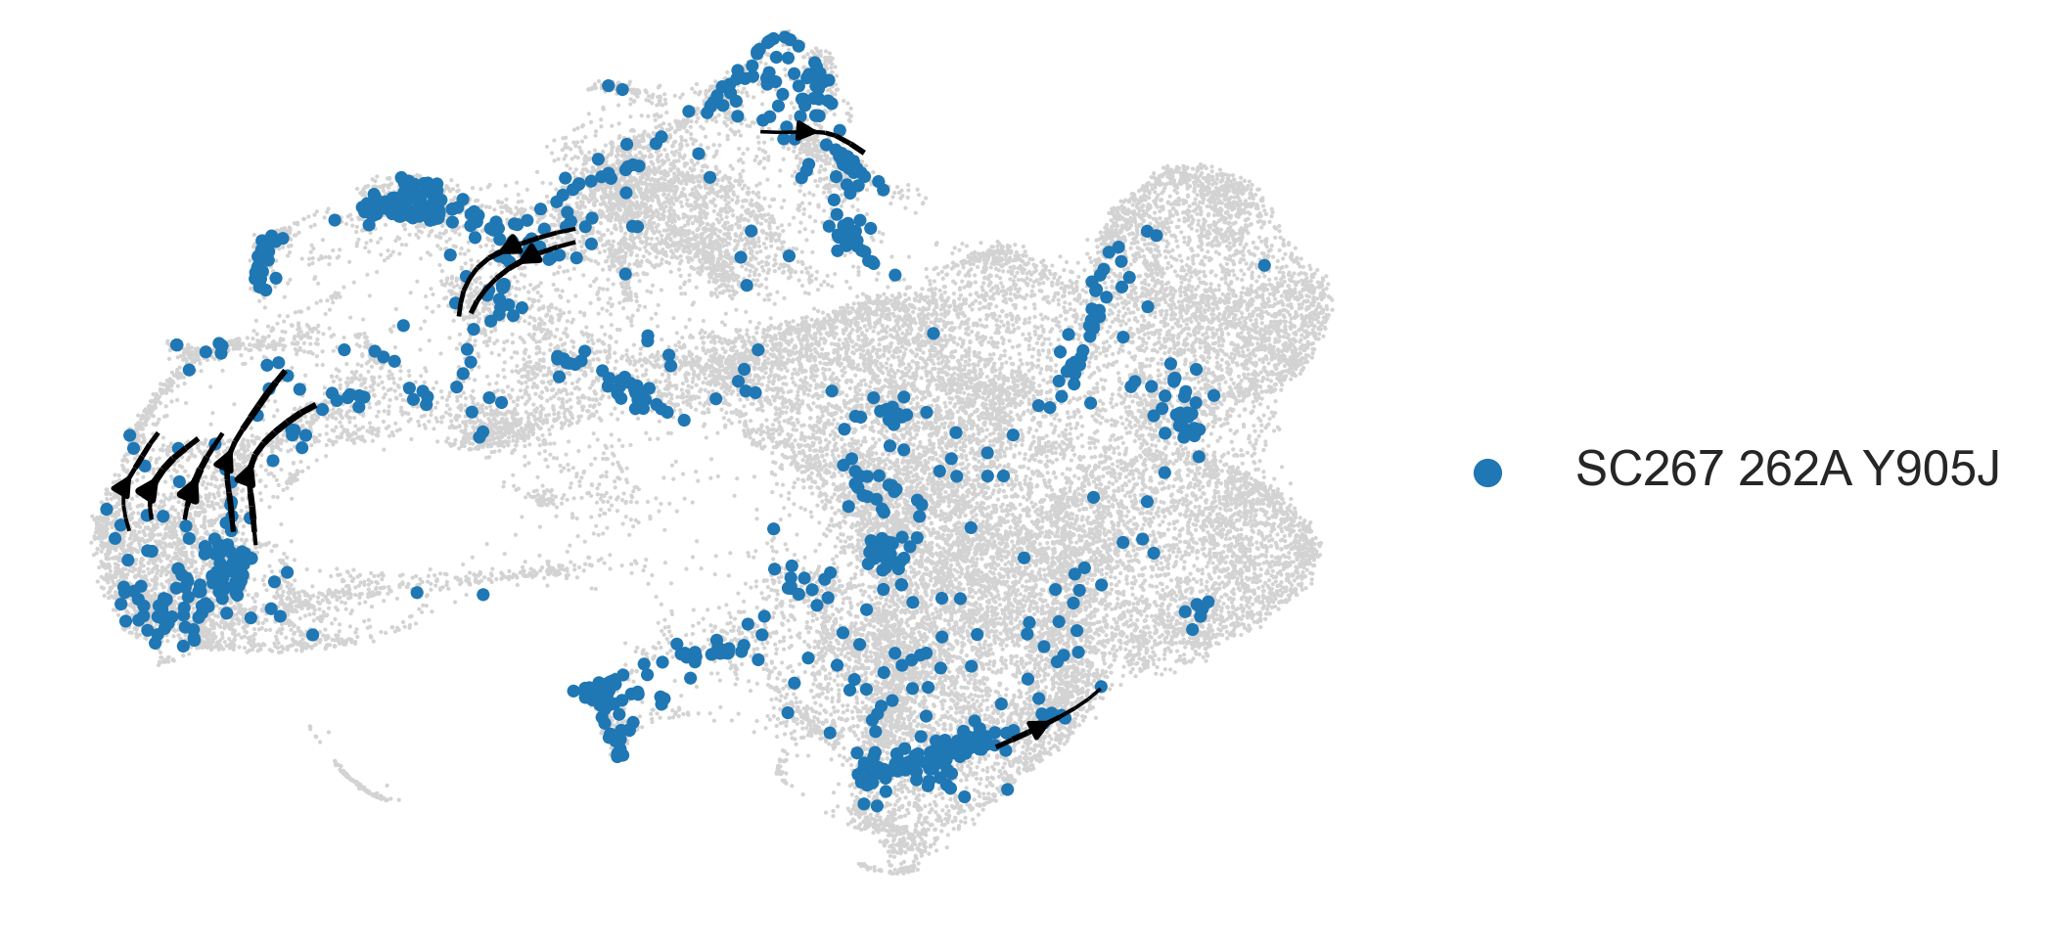
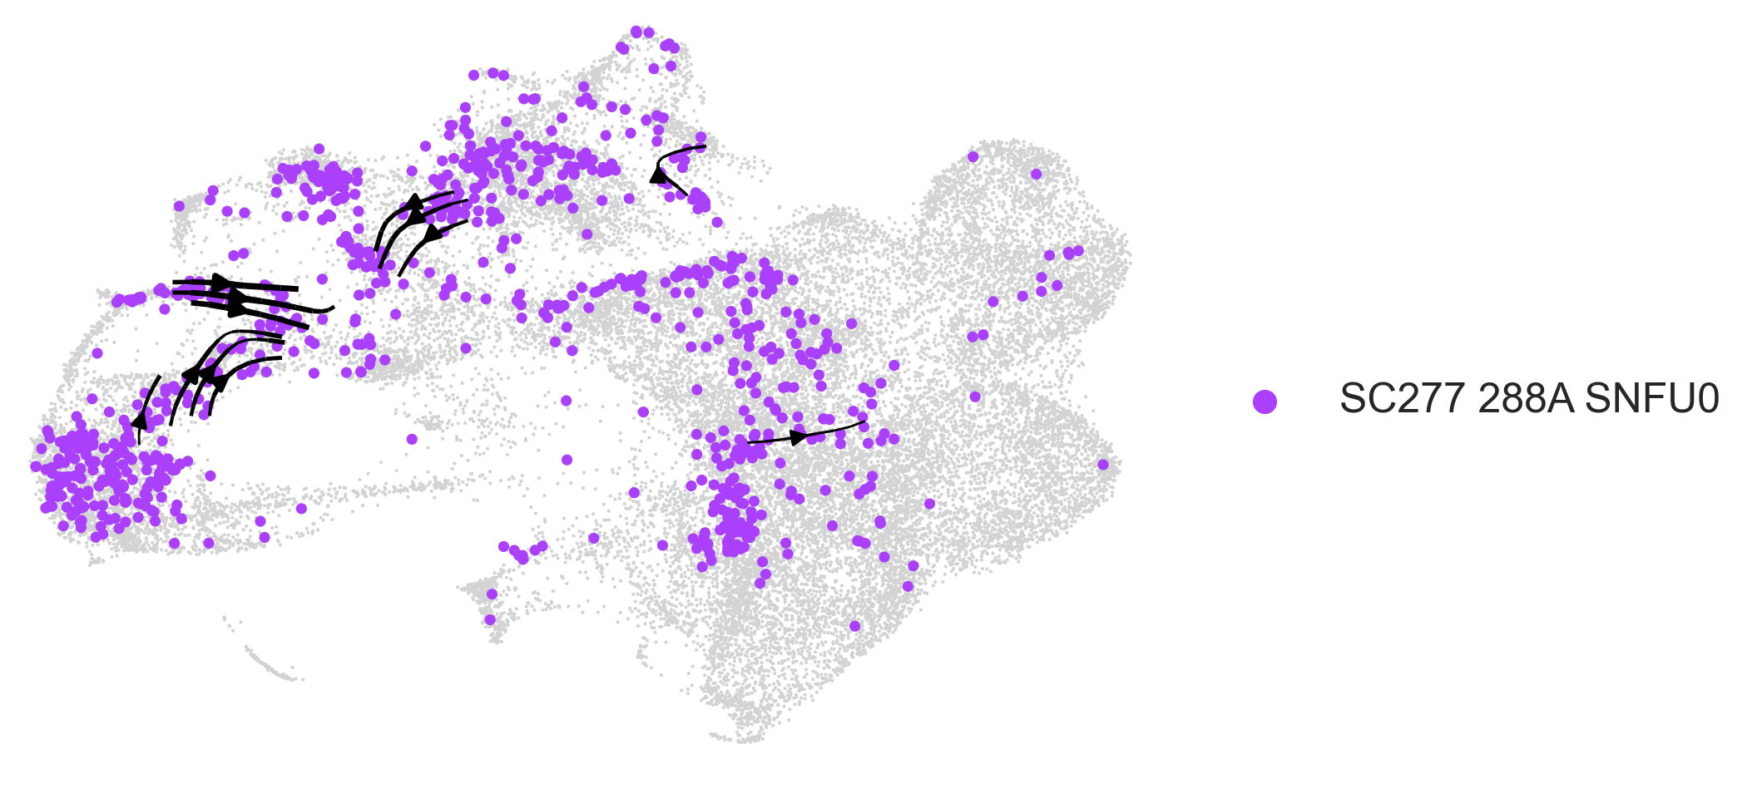
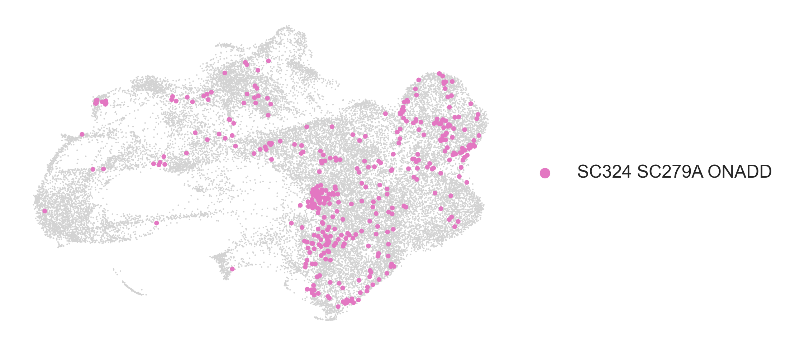

Slide 11
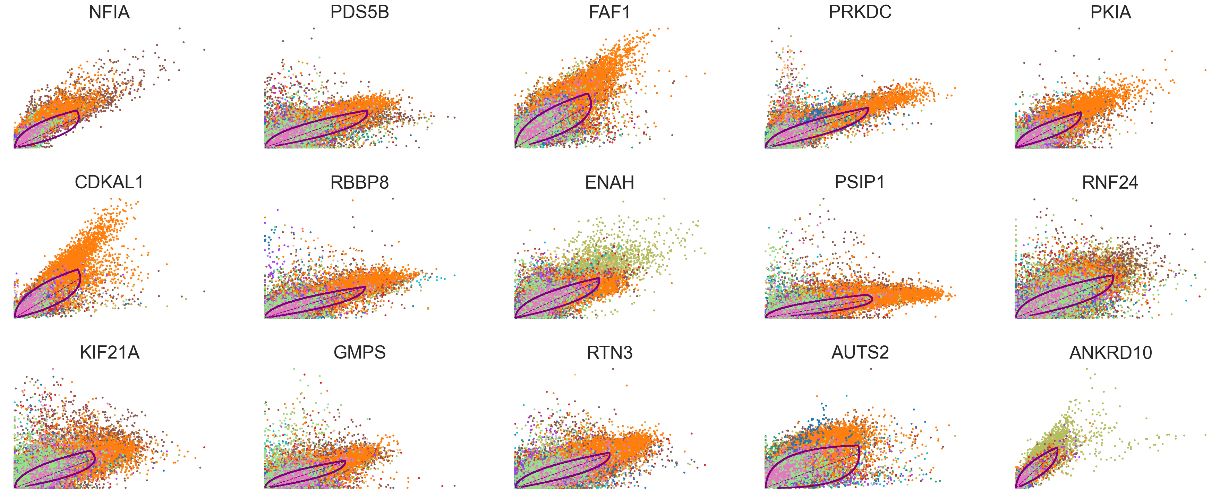
Drivers of velocity (which genes are best fit in the velocity model?)
These fits are a little concerning. We would like to see a football shape, rather than point clouds.
This may suggest that the velocities are not very well fit, or that the dynamics between samples are significantly different.

Slide 12
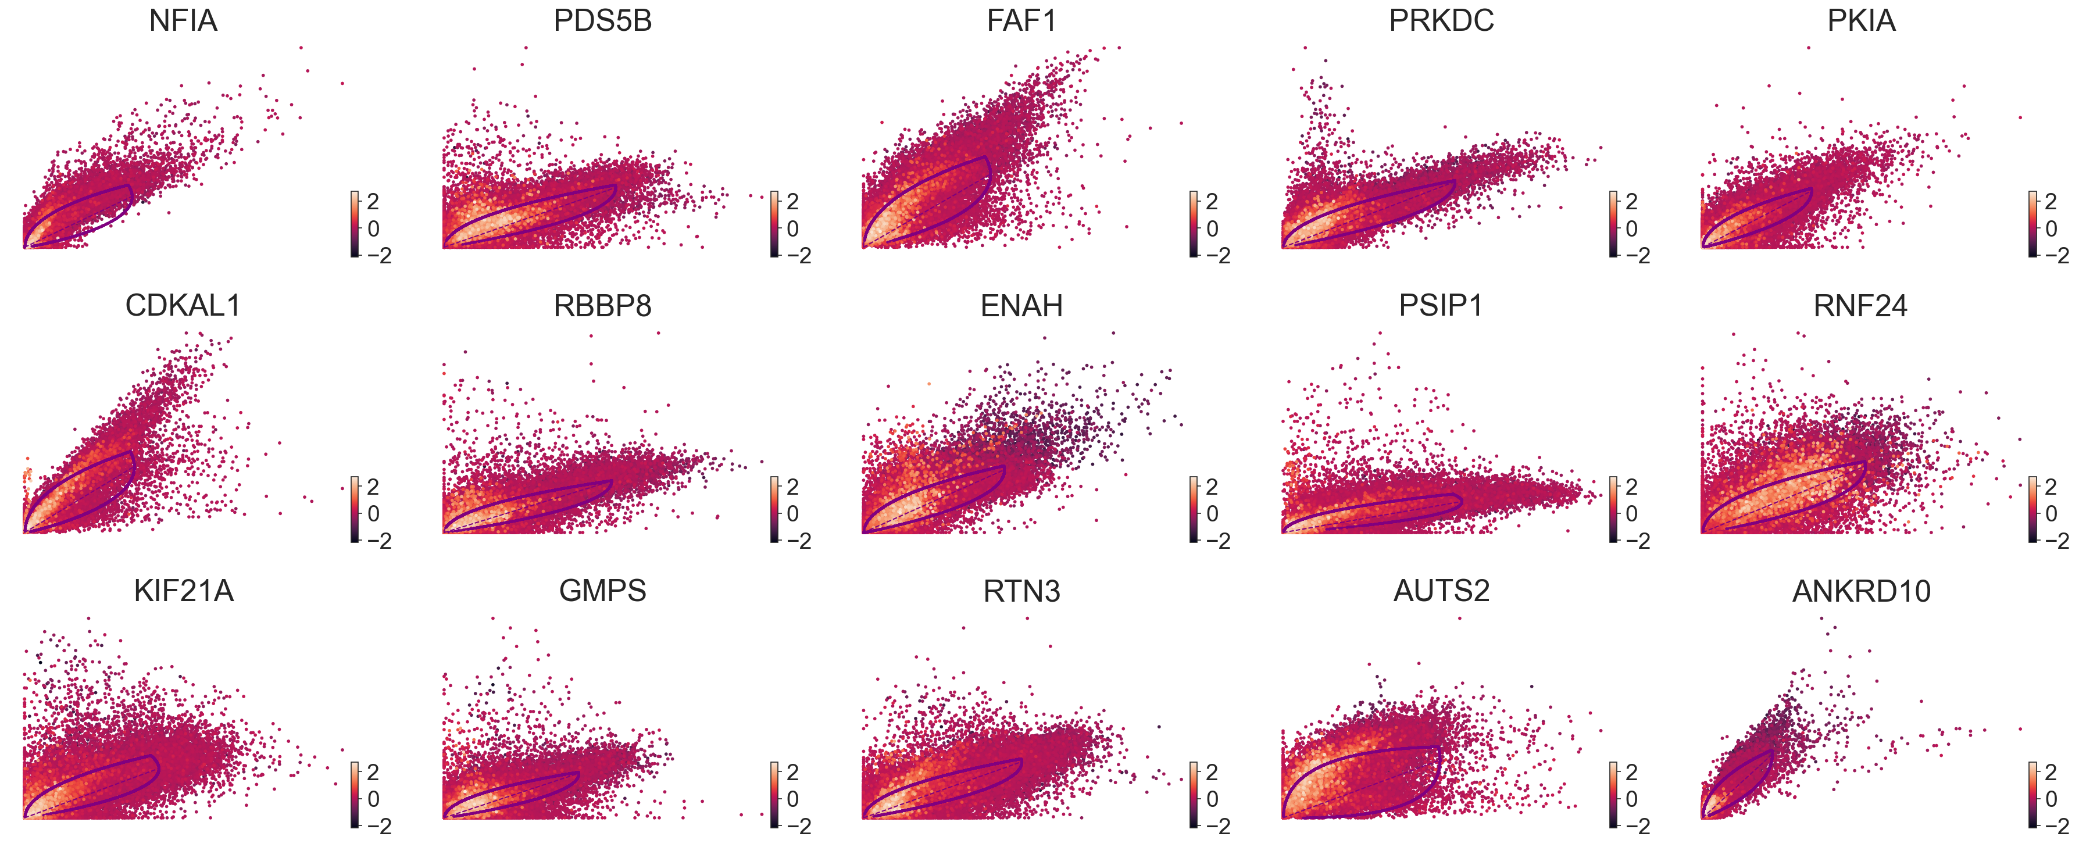
Relationship between top genes and EMT score

Slide 13
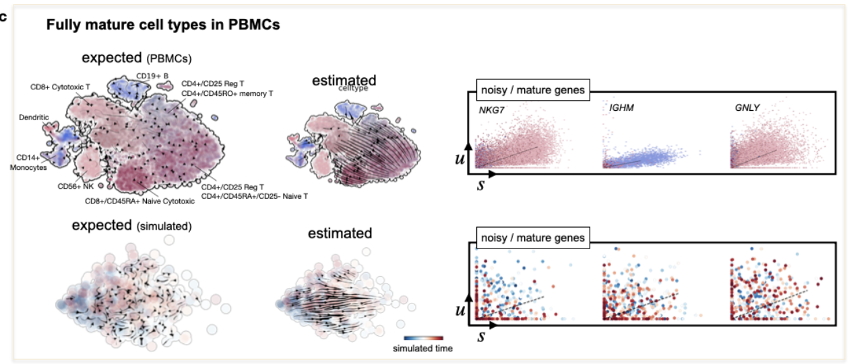

Slide 14
Cell Transport Potential
There are a few regions of low plasticity, but most cells are relatively high
EMT high cells and Yap1+ cells have highest plasticity
Yap1-
Yap1+

Slide 15
EMT high cells and Yap1+ cells have highest plasticity
EMT score is correlated with CTrP
When grouped by sample, there is a significant difference in CTrP for Yap1+ and Yap1- cells

Slide 16
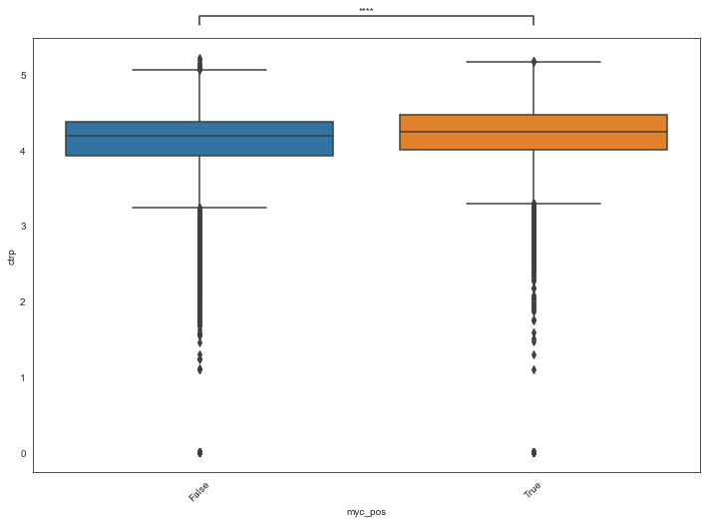
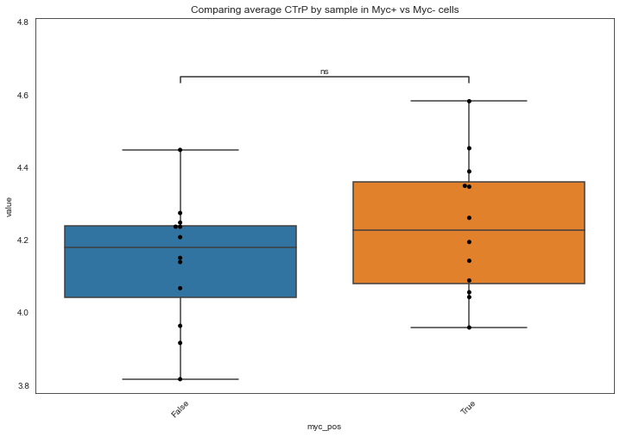
MYC and CTRP
Ungrouped
Grouped

Slide 17
Conclusions and Next steps
With the caveat that the gene fit likelihoods are not very high, there seems to be more movement in two main regions of the data
Yap1+ cells and high EMT scored cells have higher plasticity
How can we validate the higher plasticity state of the EMT high/Yap1+ cells?
While the EMT group certainly has higher velocity, the preliminary RNA velocity steps are not very convincing (i.e. the gene fits are not what we would like)
Is there another way to validate this analysis?

Slide 18
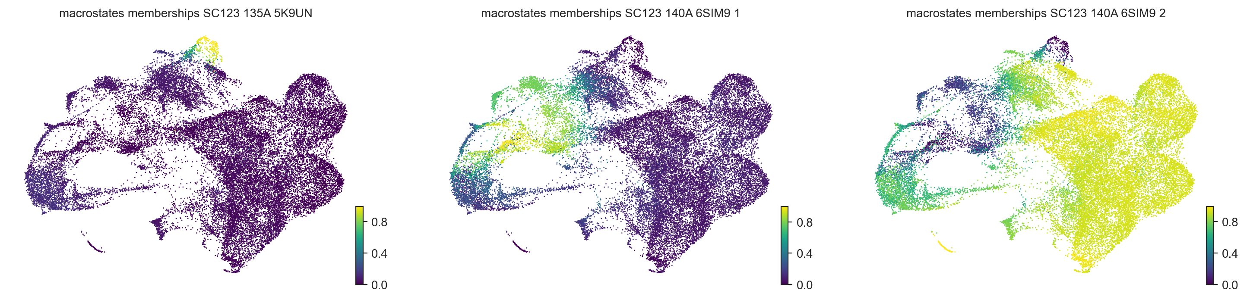
Use CellRank to compute transition matrix and cell fates
Macrostates can be state and end states

